Slide 1
Computer Networks a python chatroom with rock paper scissors
Group 19 Anirudh Gopishankar and Yohan Amaratunga

Slide 2
Content
Concept- A state-managed game server using explicit TCP sockets.
Goal- To demonstrate reliable, bidirectional client-server communication without using high-level frameworks (like HTTP).
Protocol- TCP (SOCK_STREAM) for reliable data transfer
Network Model- Client-Server (Centralised logic on pi, Clients on laptops)
Concurrency- utilised Threading to handle multiple clients (Alice and Bob) simultaneously without blocking the server loop

Slide 3
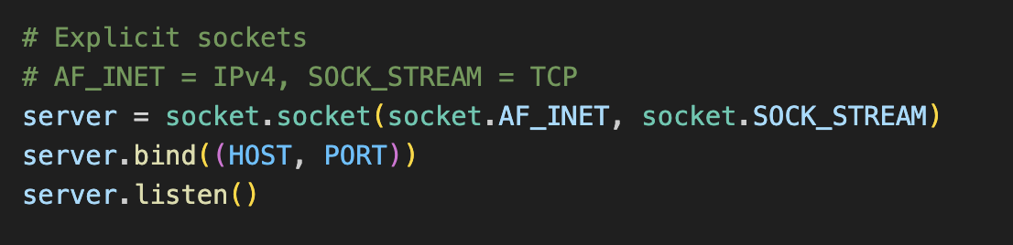
Use of Explicit Sockets

Slide 4
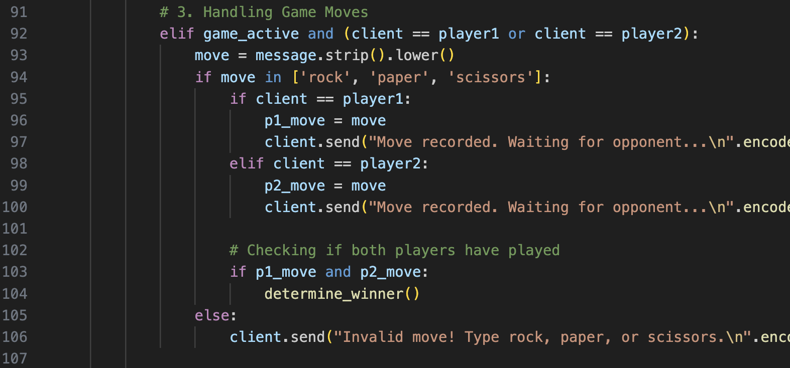
Chat messages starting with ‘/’ were intercepted and turned into game moves for rock paper scissors

Slide 5
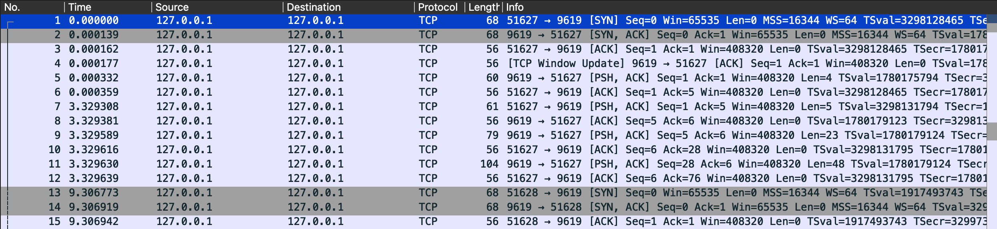
Wireshark capture of a localhost test run of the code 1. Lines 1-3 demonstrate the three-way handshake, verifying a successful connection established on port 9619 2.The PSH flag in line 5 indicates the data(player move) was pushed immediately to the application layer ensuring real time responsiveness

Slide 6
Challenge and Conclusion
Challenge- Standard chat servers broadcast every message to all clients but, for the game it had to be modified so the client who made the move is the only one who can view it and all clients cannot view the move made until the round is over.
Solution- Implementation of a conditional filler (elif block) that detects active players and intercepts game moves. It stores them in server variables (p1_move) and sends a private confirmation (client.send) instead of a public broadcast.
Conclusion- Successfully created a python live chatroom with a rock paper scissors game mode and deployed it on a raspberry pi environment along with a localhost execution of the code.

